Slide 1
FOIA Roundtable
Prepared by Mark H. Graff
NOAA FOIA Officer/Bureau Chief Privacy Officer
OCIO/CDO
mark.graff@noaa.gov; (301)-628-5658

Slide 2
FOIA Processing
Current Program Status
FOIA Intake and Perfection
Fees and Tolling
Final Determination
2

Slide 3
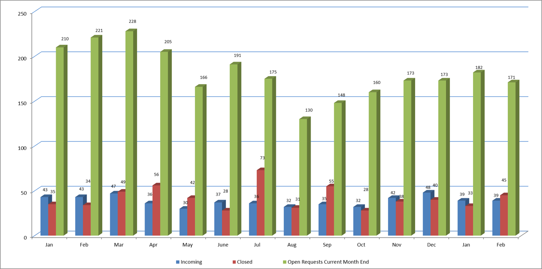
Current Program Status
3

Slide 4
Current Program Status
OPEN ACTIVE LITIGATION CASES PENDING:
FY2020: 20
FY2021: 14
FY2022: 9 (Current)
4

Slide 5
Current Program Status
The Current Backlog is 117—representing an additional 37 since end-of-FY.
Ratio of Lawsuits-to-backlog cases is 1:8.
An additional 4-5 lawsuits anticipated to result from the spike in backlog.
5

Slide 6
FOIA Intake and Perfection
FOIA Intake:
Request submission is governed by 15 CFR 4.4. Requesters can submit requests in almost any format, to any individual in the agency, seeking any agency record. If the request is misdirected to the wrong component, we are allowed 10 extra days to route the request for intake—but the request is still considered to have been properly submitted at the earlier of (1) 10 days for routing or (2) receipt by the proper component.
6
Notes:
The central facility will forward the request to the component(s) it believes most likely to have the requested records. Requests will be considered received for purposes of the 20-day time limit of § 4.6 as of the date it is received by the proper component's FOIA office, but in any event not later than ten working days after the request is first received by any Department component identified in Appendix A to this part.

Slide 7
FOIA Intake and Perfection
FOIA Intake:
Requests are routinely submitted by email, foia.gov, FOIAOnline, and mail. Requesters also have the option to fax in requests, although we have requested that DOC consider removing this option in subsequent reg revisions.
There is no restriction on the scope of the request at the point of intake, although it may not yet be considered “perfected”. The request is still logged in, and considered “received” by the agency.
7
Notes:
The central facility will forward the request to the component(s) it believes most likely to have the requested records. Requests will be considered received for purposes of the 20-day time limit of § 4.6 as of the date it is received by the proper component's FOIA office, but in any event not later than ten working days after the request is first received by any Department component identified in Appendix A to this part.

Slide 8
FOIA Intake and Perfection
FOIA Intake:
If the request is seeking records about the requester under the Privacy Act, the request must also comply with 15 CFR 4.24, including identifying the request as a Privacy Act request, and verifying the identity of the requester—which can be done by either a notarized certification, or by a perjury statement identifying the requester as the submitter of the request.
8
Notes:
The central facility will forward the request to the component(s) it believes most likely to have the requested records. Requests will be considered received for purposes of the 20-day time limit of § 4.6 as of the date it is received by the proper component's FOIA office, but in any event not later than ten working days after the request is first received by any Department component identified in Appendix A to this part. There has been clarification in one case, where the requester sought all records about themselves, not specifying any context, and sued arguing every field office in the FBI should have been searched. Marks v. DOJ, 578 F.2d 261, 263 (9th Cir. 1978)
(declaring that "reasonable description relates not only to subject matter, but . . . also relates
to place of search" and ruling that FBI was not required to search all field offices pursuant to
request for all records "under [my] name" because such "broad, sweeping requests" do not "reasonably describe" records sought)

Slide 9
FOIA Intake and Perfection
FOIA Perfection:
Requests must first “reasonably describe” the records being sought. This requirement is not yet considering the volume of records or burden of the search, (although the burden of processing a request must be considered to perfect a request). Rather, “reasonably describing the records” concerns whether or not the subject matter is defined so that the agency can determine precisely what records are being requested.
9
Notes:
Yeager v. DEA. 678 F.2d 315, 322, 326 (D.C. Cir. 1982). Request sought over 1,000,000 computerized records—but request was considered to be valid, as it clearly defined the records it was seeking. a) A copy of the record layout outlining the available data stored either electronically or on data cards for NADDIS, KISS, PATHFINDER and NIMROD. The central facility will forward the request to the component(s) it believes most likely to have the requested records. Requests will be considered received for purposes of the 20-day time limit of § 4.6 as of the date it is received by the proper component's FOIA office, but in any event not later than ten working days after the request is first received by any Department component identified in Appendix A to this part. There has been clarification in one case, where the requester sought all records about themselves, not specifying any context, and sued arguing every field office in the FBI should have been searched. Marks v. DOJ, 578 F.2d 261, 263 (9th Cir. 1978)
(declaring that "reasonable description relates not only to subject matter, but . . . also relates
to place of search" and ruling that FBI was not required to search all field offices pursuant to
request for all records "under [my] name" because such "broad, sweeping requests" do not "reasonably describe" records sought).

Slide 10
FOIA Intake and Perfection
FOIA Perfection:
As recent examples, the agency can readily determine the records being sought if a requester seeks all emails from a group of individuals, or all calendar events, notes, and attachments for the calendars for a set of SES members. However, requesters must give custodians, document types, types of information, or enough date and subject matter restrictions to physically conduct the search to meet the “reasonably describe the records” standard.
10
Notes:
Yagman v. Pompeo, 868 F.3d 1075, 1081 (9th Cir. 2017) (finding request not reasonably described where request "does not identify specific persons, much less specific documents, types of documents, types of information," or "suggest much in the way of times, dates, [or] locations") (Requester had asked for “[r]ecords/information' identifying CIA employees or affiliates who have engaged in torture after September 11, 2001.”)

Slide 11
FOIA Intake and Perfection
FOIA Perfection:
Also separate from the volume of the records is the amount of effort necessary to conduct the search itself. This still is tied to the requirement to reasonably describe the records being sought; specifically, the search must enable a professional agency employee familiar with the subject to locate the record with a reasonable amount of effort.
11
Notes:
Found. v. DOJ, 211 F. Supp. 3d 311, 318 (D.D.C. 2016) (finding that "Defendant contends, and the court agrees, that Plaintiff's request for '[r]ecords evincing the use of' personal email accounts and other electronic communication and social media platforms to conduct government business does not enable a professional DOJ employee to determine what records are being sought“
--Courts noted that “FOIA was not intended to reduce government agencies to full-time investigators on behalf of requesters.” (Assassination Archives & Rsch Ctr. V. CIA, 720 F. Supp. 217, 219 (D.D.C. 1989).

Slide 12
FOIA Intake and Perfection
FOIA Perfection:
FOIA staff is neither required to have "clairvoyant capabilities" to discern the requester's needs, nor must they spend "countless numbers of personnel hours seeking needles in bureaucratic haystacks.“
If multi-step requests are submitted require a search to identify the locations to conduct another search—contact the requester to better identify the scope of the request.
12
Notes:
Devine v. Marsh, 2 Gov't Disclosure Serv. (P-H) ¶ 82,022, 82,186 (E.D. Va. Aug. 27, 1981).

Slide 13
FOIA Intake and Perfection
FOIA Perfection:
A request also is not perfect if it is “asking a question” rather than seeking records. NOAA is not required to answer questions, create new records, or modify exempt material to make it disclosable. Similarly, we are not required—during the administrative processing phase—to provide a Vaughn index or similar index of records.
13
Notes:
Hall & Assocs. v. EPA, No. 16-5315, 2018 WL 1896493, at *2 (D.C. Cir. Apr. 9, 2018)—questions don’t count as requests; Singh v. FAA, 783 F. App'x 753, 754 (9th Cir. 2019) (rejecting plaintiff's contention that FAA could have used certain geographic data that it maintained to piece together information that was responsive to the request because "FOIA does not require agencies to create new records");
However, N.Y. Times Co. v. FCC, 457 F.Supp.3d 266, 277 (S.D.N.Y. 2020) (finding that where data points requested exist in an Application Programming Interface server log, the log is searchable using a script and the agency failed to show this particular script would interfere with operations, the "FOIA 'clearly require[s] agencies to sort a pre-existing database of information to make information intelligible so that it may be transmitted to the public . . . [and] [a]ccordingly, conducting such a search cannot constitute . . . conducting research so as to fall outside of agency disclosure requirements.")

Slide 14
FOIA Intake and Perfection
Unreasonably Burdensome:
As a corollary to the "reasonably described" inquiry, courts have held that agencies are not required to conduct wide-ranging, "unreasonably burdensome" searches for records.
14
Notes:
Dixon v. DOJ, 279 F. Supp. 3d 1, 2 (D.D.C. 2017) ("Where . . . an agency's response to a FOIA request calls for 'an unreasonably burdensome search,' . . .
the agency need not honor the request. (FBI's assessment that the [portion] of Plaintiff's FOIA request [concerning "who 'used the bullet evidence at trial' to gain conviction, specifically of those charged with cases where [compositional bullet lead analysis] was used, and later lead to reversal"] does not reasonably describe the records requested." "Furthermore, a substantive response to [this request] would require that FBI staff locate letters or memoranda from prosecutors' offices throughout the country, identify each criminal matter for which the FBI conducted comparative bullet lead analysis, and determine the cases resulting in a conviction which subsequently was reversed[.]“)

Slide 15
FOIA Intake and Perfection
Unreasonably Burdensome:
As such—if a request does not reasonably describe the records being sought, OR is unduly burdensome, the request is received, but not perfected, and clarification from the requester should be sought. If you have received an unperfected request—issue the clarification letter noting the deficiency, and ask NOAA FOIA to “un-perfect the request” and immediately toll the request.
15
Notes:
Must give reasonable interpretation—if clarity is needed, reach out to the requester. Cannot narrow the scope without requester consent. LaCedra v. EOUSA, 317 F.3d 345, 347-48 (D.C. Cir. 2003) (concluding that agency failed
to "liberally construe" request for "all documents pertaining to [plaintiff's] case" when it limited that request's scope to only those records specifically and individually listed in request letter because "drafter of a FOIA request might reasonably seek all of a certain set of
documents while nonetheless evincing a heightened interest in a specific subset thereof“. ; Laws. Comm. for C.R. v. Dep't of the Treasury, 534
F. Supp. 2d 1126, 1135-36 (N.D. Cal. 2008) (concluding that requests must be "interpreted
liberally and . . . an agency cannot withhold a record that is reasonably within the scope of
the request on the grounds that the record has not been specifically named by the
requester")

Slide 16
Fees and Tolling
FOIA Fees:
Fees can only be assessed in accordance with 15 CFR 4.11. As such, first we have to determine the fee waiver eligibility of the requester (if requested). This will be done at intake.
16
Notes:
If you disagree with the fee waiver eligibility of a requester based off of the 6 factor test outlined in 15 CFR 4.11(l), please contact NOAA FOIA.

Slide 17
Fees and Tolling
FOIA Fees:
If fees are waived, then the fee category is moot. However, if fees are not waived, then a fee estimate should be sent to the requester immediately by the LO following tasking.
17

Slide 18
Fees and Tolling
FOIA Fees:
15 CFR 4.11(e), the request is tolled only upon notification of the requester of the fee estimate. This tolling can be done multiple times as requesters narrow their scope, and a new fee estimate is issued again.
18

Slide 19
Fees and Tolling
Clarification Tolling:
Under the 2016 FOIA Improvement Act, we are allowed one clarification tolling event. This is a separate tolling that cannot be performed more than once, even if the request still requires clarification.
19
Notes:
5 USC 552(a)(6)(a)(ii)(I)

Slide 20
Fees and Tolling
Clarification Tolling:
It is recommended that Line Offices coordinate this one clarification between all Offices with responsive records—as other Line Offices will be impacted by the scope of the clarification provided by the requester, but will not have the ability to further toll the request.
20
Notes:
5 USC 552(a)(6)(a)(ii)(I)

Slide 21
Final Determination
Appeal Rights:
Any denial must (1) be signed by a denial authority under 15 CFR Part 4 Appendix B, and (2) must include appeal rights. Appeals should also be included in interim releases, as well as full releases, as exemptions can be appealed during the case, and the scope of the search can be appealed following a full release.
21
Notes:
See 15 CFR 4.7

Slide 22
Final Determination
Request, Appeal, Consultation, or Referral:
Each type of request can have a different required response, including regular responses to the requester, reprocessing a portion of the request on remand, recommending exemptions to the consulting agency, or asserting exemptions on a set of records already located by a referring agency. You must know which type of request you are processing.
22
Notes:
See 15 CFR 4.7

Slide 23
Final Determination
Exhaustion of Administrative Remedies
In order to file suit, Courts require requesters to exhaust their administrative remedies. This can be done either by filing an administrative appeal of a denial, or by the Agency’s failure to respond in time, which is referred to as constructive denial.
As a result, it is always advisable to make some interim release to the Plaintiff prior to the expiration of the time limit to require the requester to exhaust administrative remedies as to that release.
23
Notes:
See 15 CFR 4.7

Slide 24
Questions
QUESTIONS?
24

